Slide 1



Data Science Project
Tengfei Ye | Ebunoluwa Adebesin | Xingguang Chen
Northeastern University
College of Engineering
Multidisciplinary Graduate Engineering Department
INFO 6105 – Fall 2024
Instructor: Abdolreza Mosaddegh

Slide 2
Data Pre-processing
Step 1

Slide 3
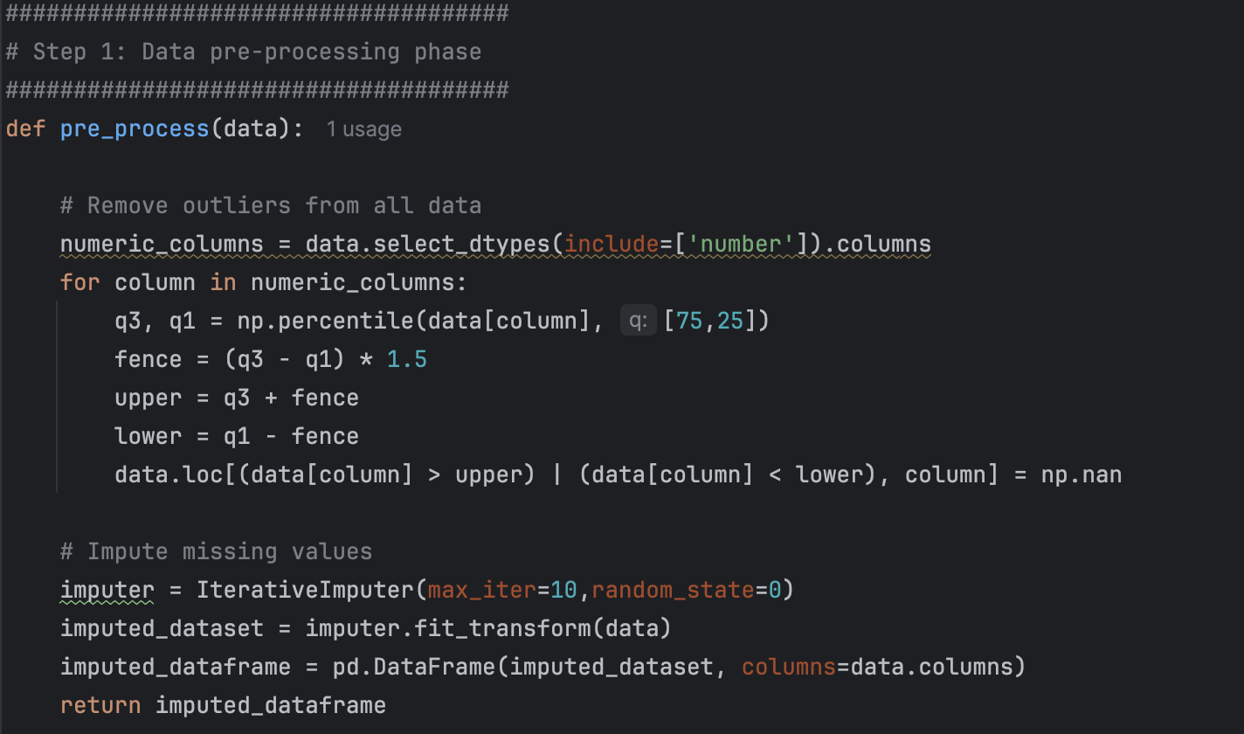
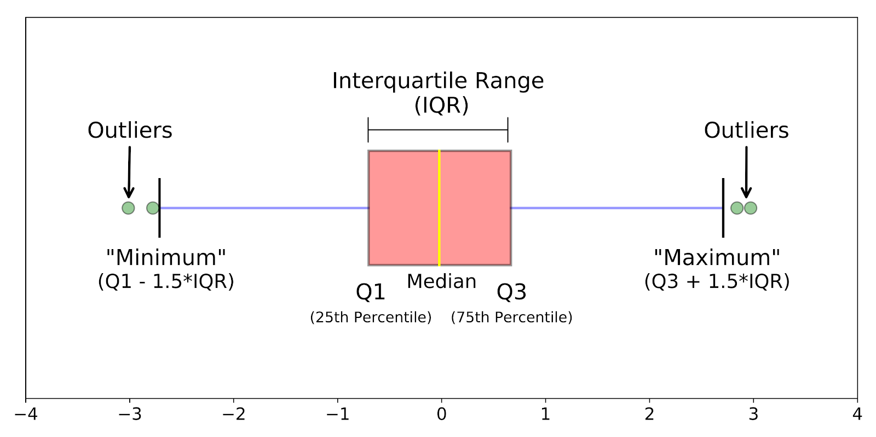
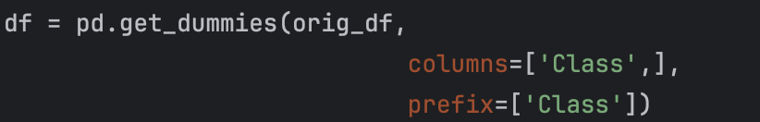
Data Pre-processing
IQR Method
import numpy as np
Imputer Method
from sklearn.impute import IterativeImputer
One-hot Encoding for Step 5

Slide 4
Generating Labels
Step 2

Slide 5
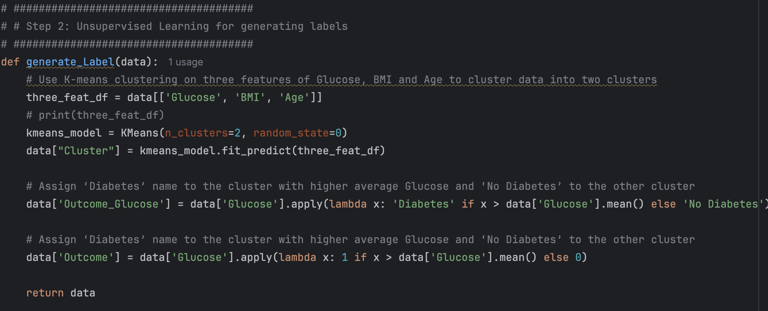
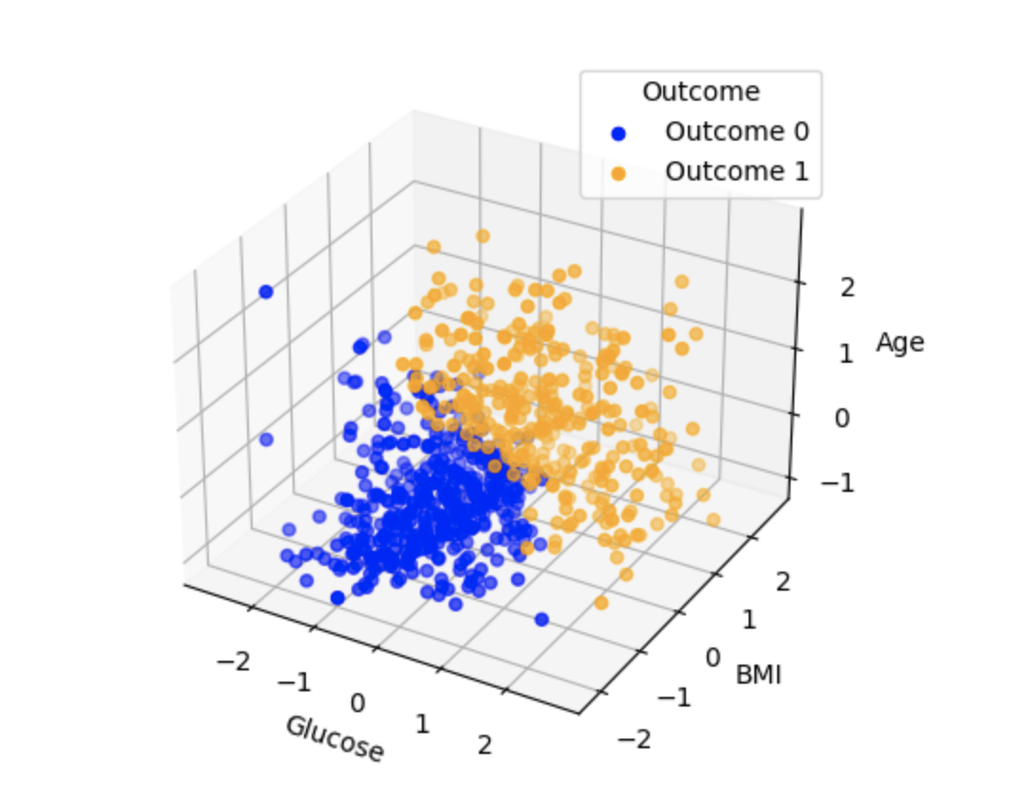
Generating Labels
Use K-means clustering

Slide 6
Feature Extraction
Step 3

Slide 7
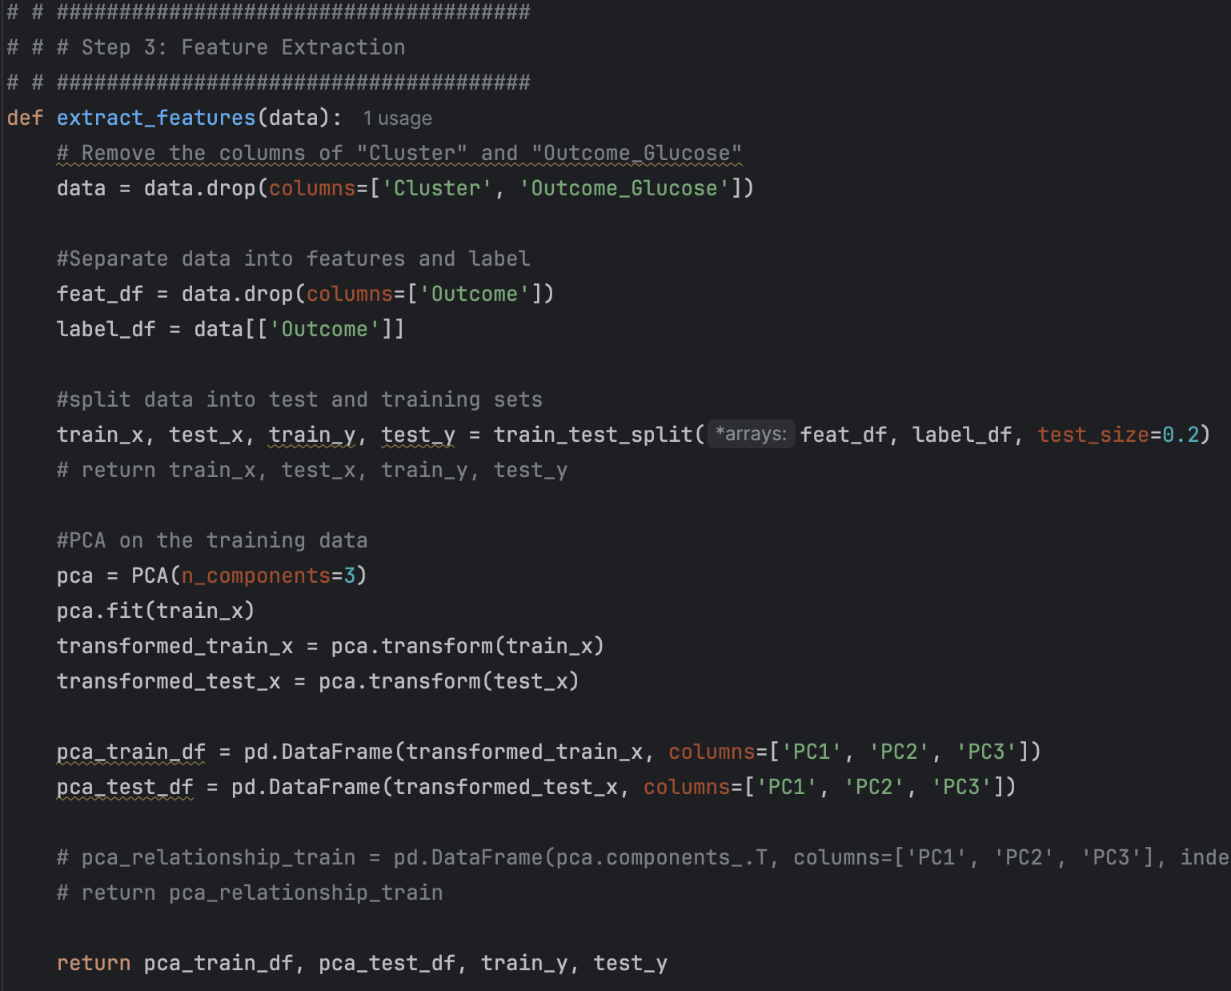
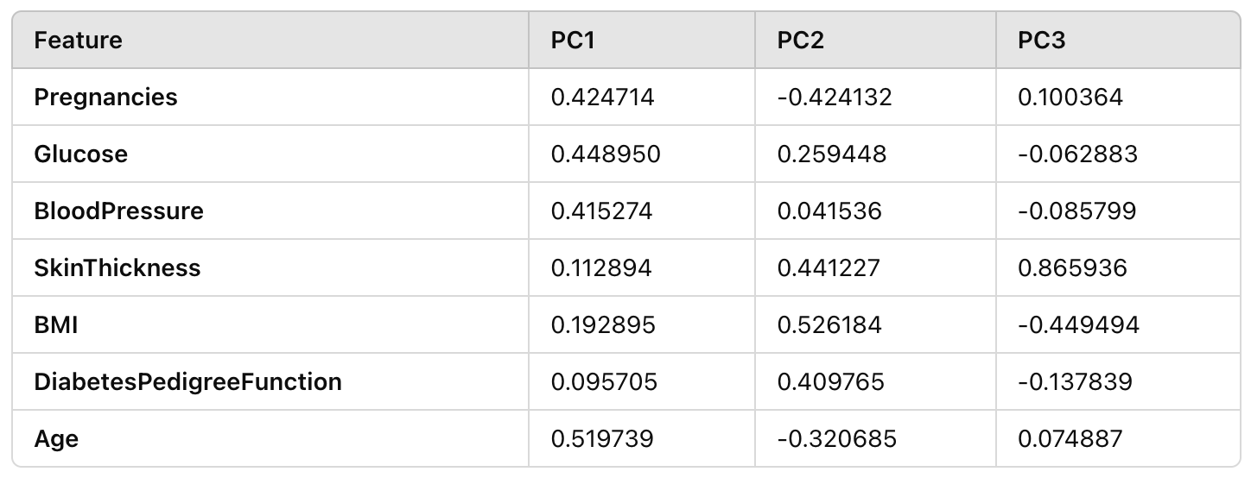
Feature Extraction
Using PCA method
PC1 (Principal Component 1): It has relatively strong positive loadings for Glucose, Pregnancies, and BloodPressure. Age also has a moderate positive loading.
PC2 (Principal Component 2): It is influenced mostly by BMI and SkinThickness, with positive loadings. Pregnancies has a negative loading on PC2.
PC3 (Principal Component 3): This component seems to primarily represent SkinThickness (with a large positive loading) and BMI (negative loading). It likely reflects the differences related to SkinThickness and BMI in the dataset, as SkinThickness has the largest positive value on this component.

Slide 8
Meta Learner
Step 4

Slide 9

Meta Learner
Individual Tuning
Joint Tuning
• Joint optimization of the base models and meta-learner can, in theory, produce better results.
However, this approach is computationally expensive and complex because:
• It requires simultaneous hyperparameter tuning across multiple models.
• Changes in base model hyperparameters affect the meta-features, which impacts the meta-learner’s performance.
• The search space becomes very large.
So we choose Individual Tuning:
1. Train Base Models Separately
2. Generate Meta-Features
3. Train the Meta-Learner

Slide 10
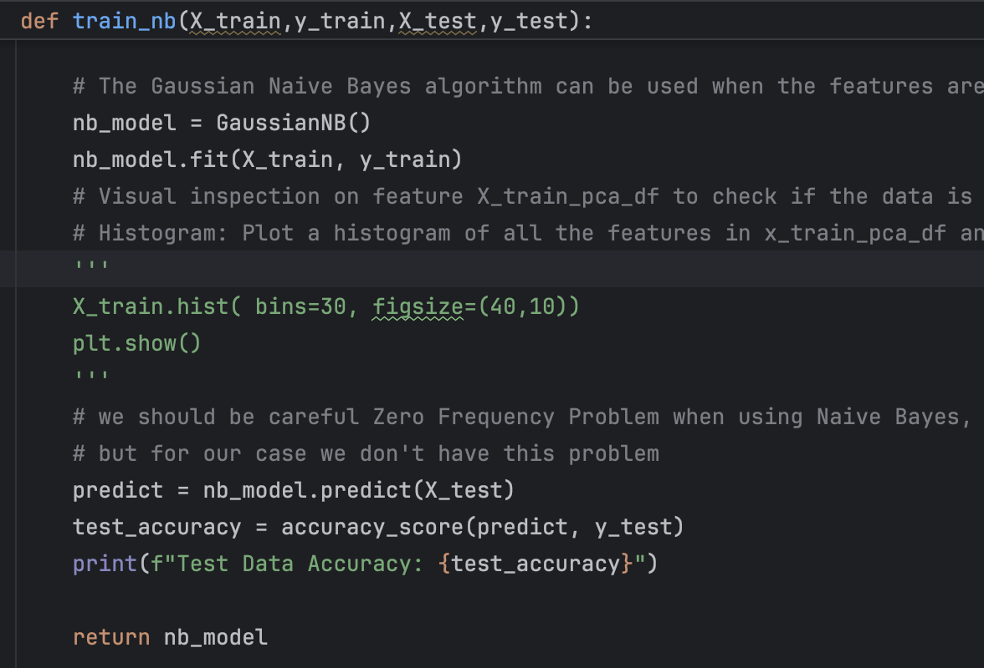
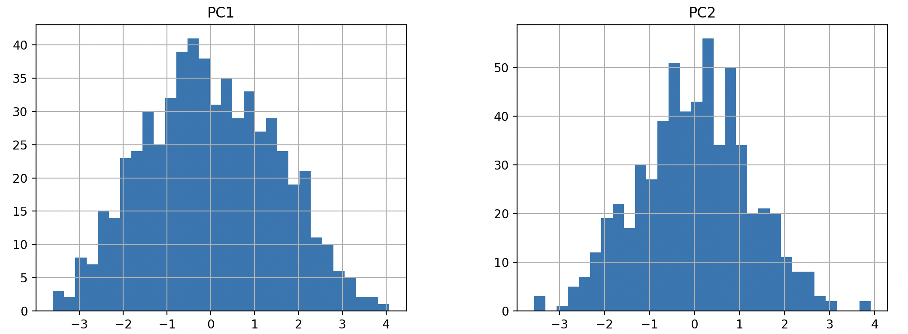
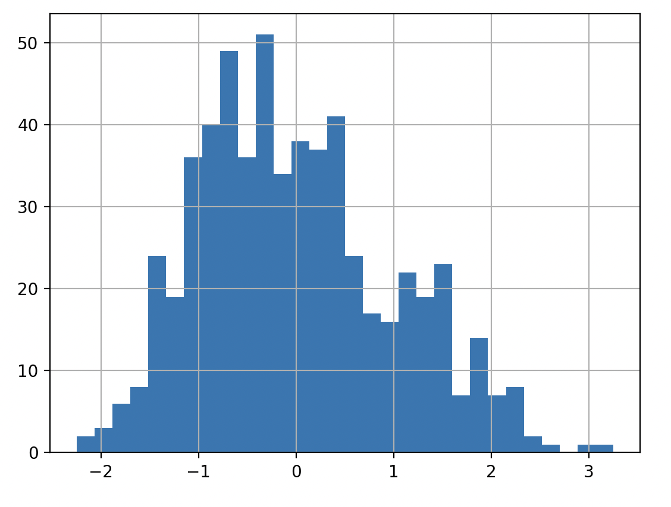
Base Model - Naive Bayers
The Gaussian Naive Bayes algorithm can be used when the features are continuous. It assumes that the continuous features follow a normal (Gaussian) distribution.
Train Data Accuracy: 0.8668941979522184
Test Data Accuracy: 0.8231292517006803

Slide 11
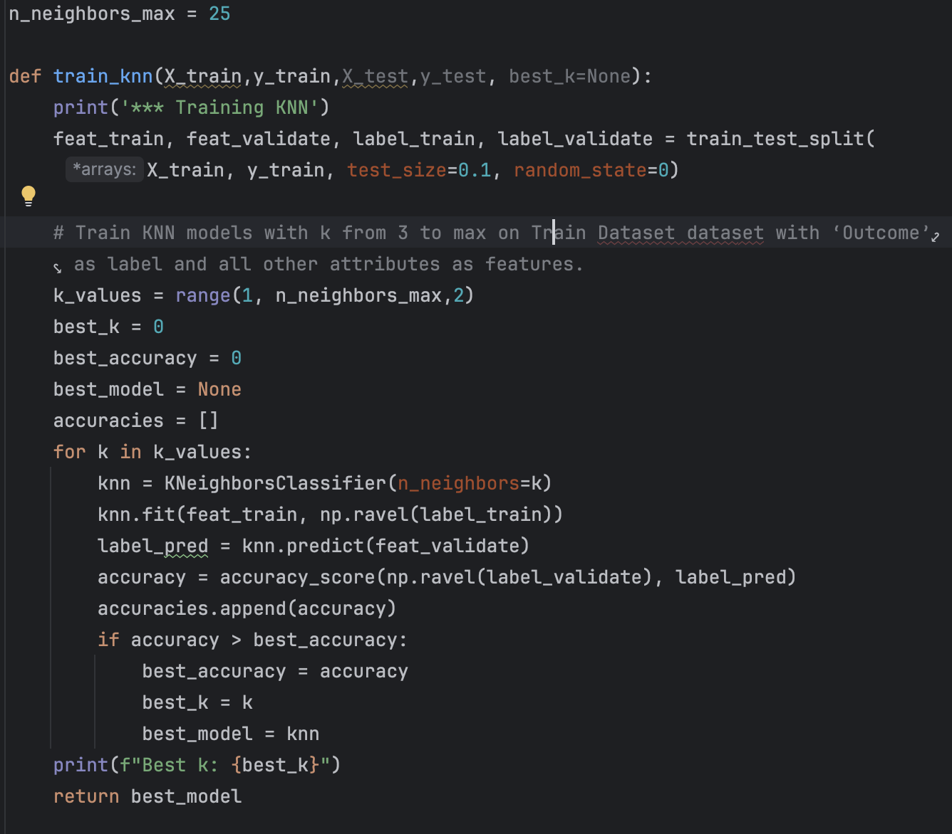
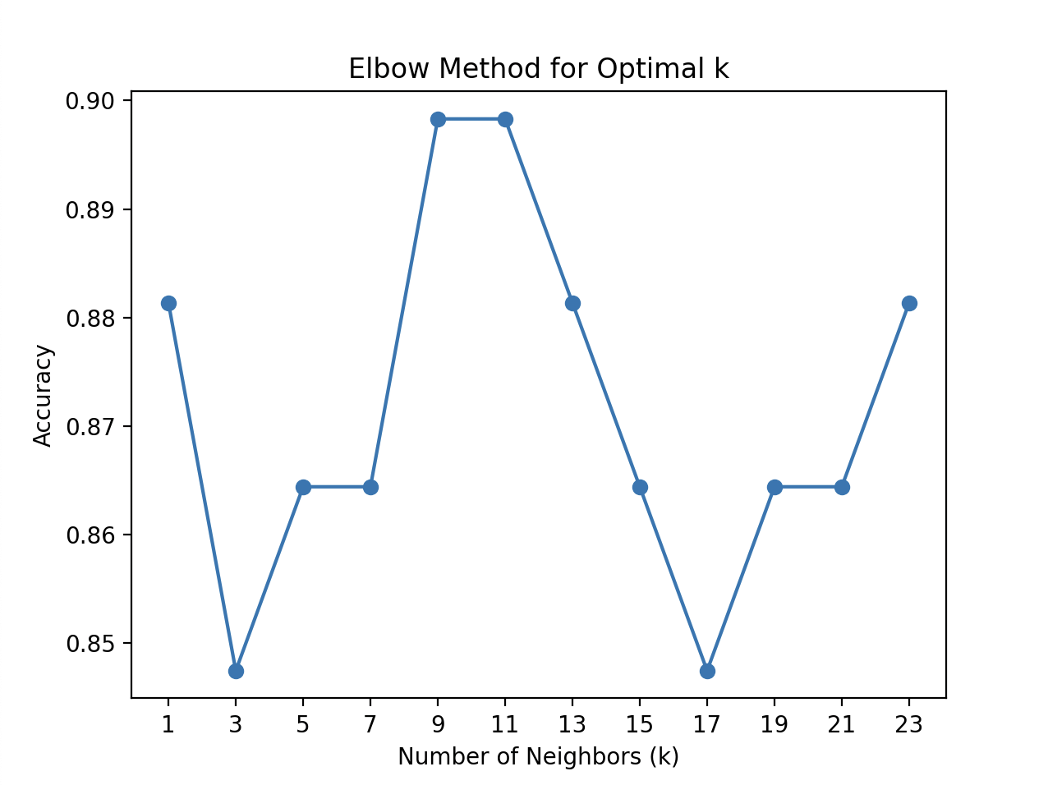
Base Model - KNN
Try to find best parameter: n_neighbors and metric
Rule of thumb:
K <= sqrt(N)
N: number of training points
Best k: 9
Best Accuracy: 0.8983050847457628
Train Data Accuracy: 0.8959044368600683
Test Data Accuracy: 0.8707482993197279

Slide 12
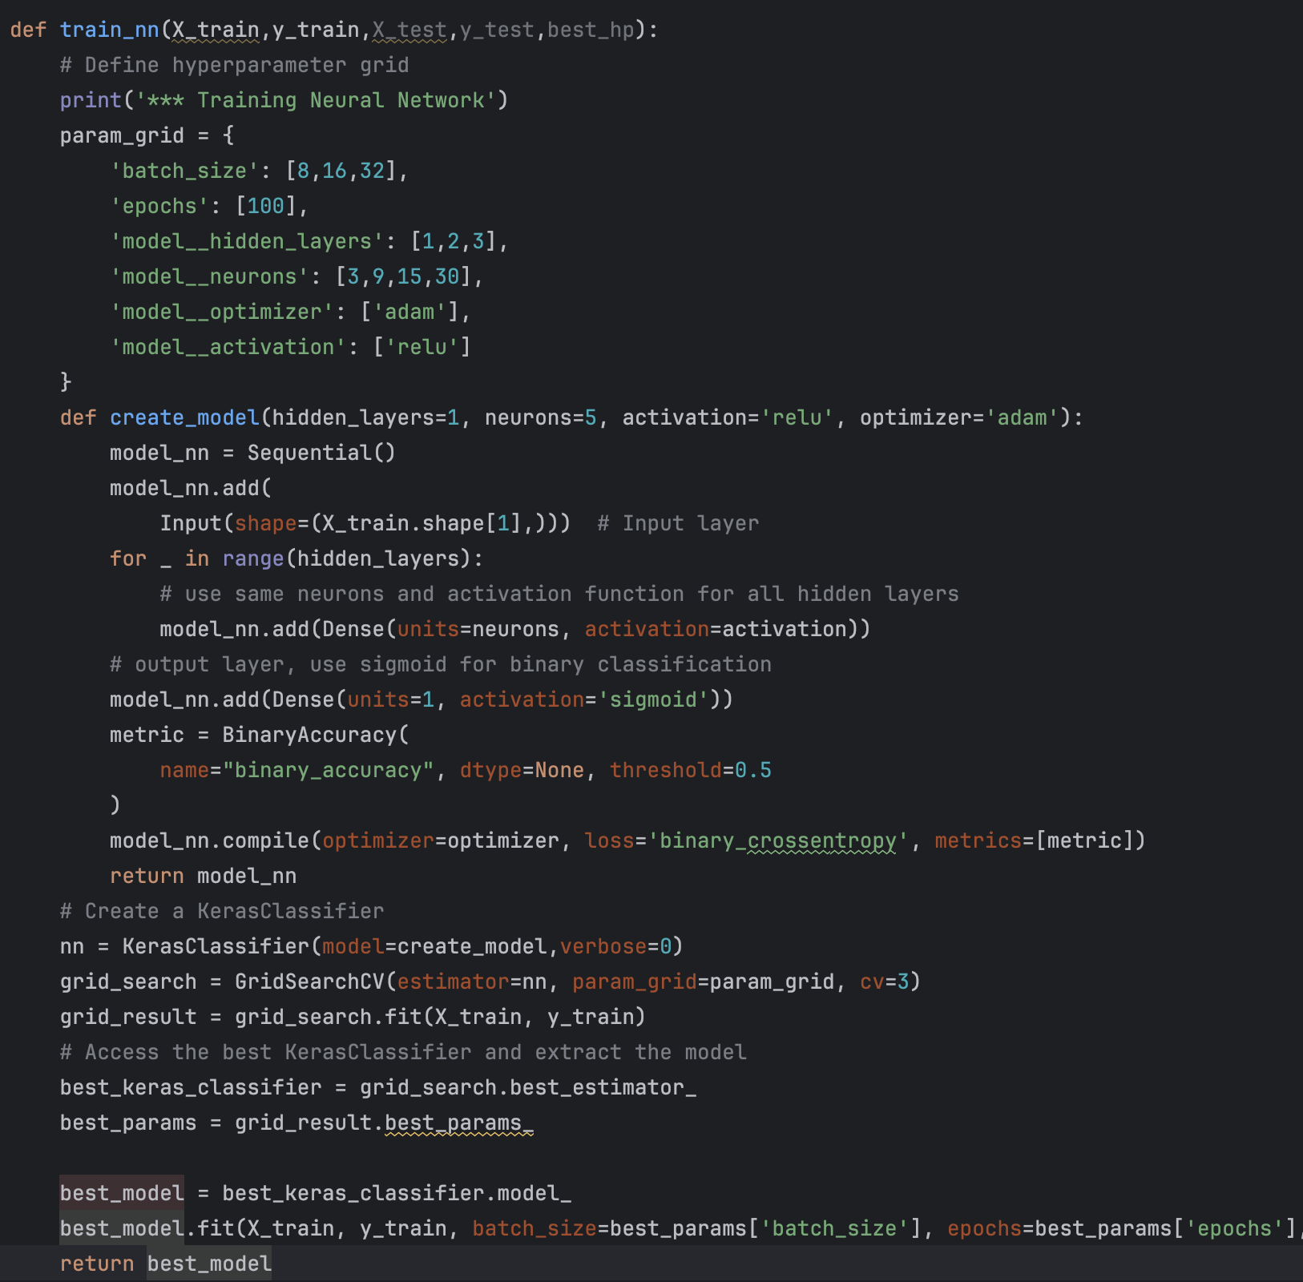
Base Model – Neuron Networks
Hyper Parameters Options
1: input layer have the same neuron numbers as features
2:to make the code more simple, each hidden layer have the same amount of neurons.
3: output layer using sigmoid as classification function
4:run cross verification to find the best parameter
5:fit the model with the whole train dataset
Best Parameters: {'batch_size': 16, 'epochs': 100, 'model__activation': 'relu', 'model__hidden_layers': 2, 'model__neurons': 9, 'model__optimizer': 'adam’}
Best Cross-Validation Score: 0.8907849829351535

Slide 13
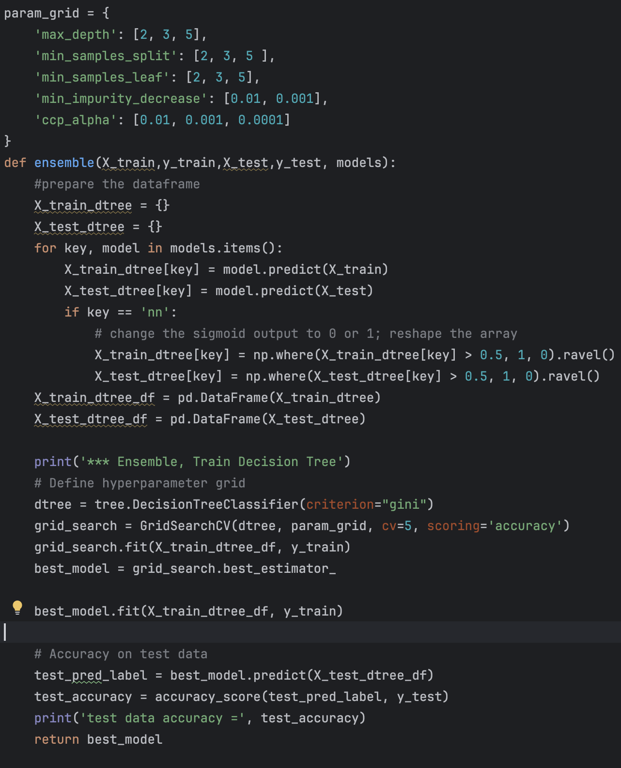
Meta Learner
Hyper Parameters Options
1: using the predicted value from base learner as features. Prepare the data fame
** We need to change the output of NN to be classification data : 0/1
2: use GridSearchCV with CV=5 to find the best parameter
3:fit the model with the whole train dataset
Best parameter: {'ccp_alpha': 0.001, 'max_depth': 3, 'min_impurity_decrease': 0.001, 'min_samples_leaf': 2, 'min_samples_split': 2}
*** Ensemble, Train Decision Tree
Train Data Accuracy: 0.9010238907849829
test data accuracy = 0.8775510204081632

Slide 14
Final result
Hyper Parameters Options
*** Training Naive Bayes
Train Data Accuracy: 0.8686006825938567
Test Data Accuracy: 0.8503401360544217
*** Training KNN
Train Data Accuracy: 0.8959044368600683
Test Data Accuracy: 0.8707482993197279
Best K = 9
*** Training Neural Network
Train Data Accuracy: 0.9010238647460938
test data accuracy= 0.8707482814788818
hidden_layers= 2 neurons= 9 batch_size=16 epochs=100
*** Ensemble, Train Decision Tree
Train Data Accuracy: 0.9010238907849829
test data accuracy = 0.8775510204081632
Best parameter: {'ccp_alpha': 0.001, 'max_depth': 3, 'min_impurity_decrease': 0.001, 'min_samples_leaf': 2, 'min_samples_split': 2}

Slide 15
Employing the model on another dataset
Step 5
Notes:
Step 5: Overview
Dataset: Airline Passenger Satisfaction
Goal: Predict passenger satisfaction using multiple machine learning models
Approach: Advanced data preprocessing and model comparison

Slide 16
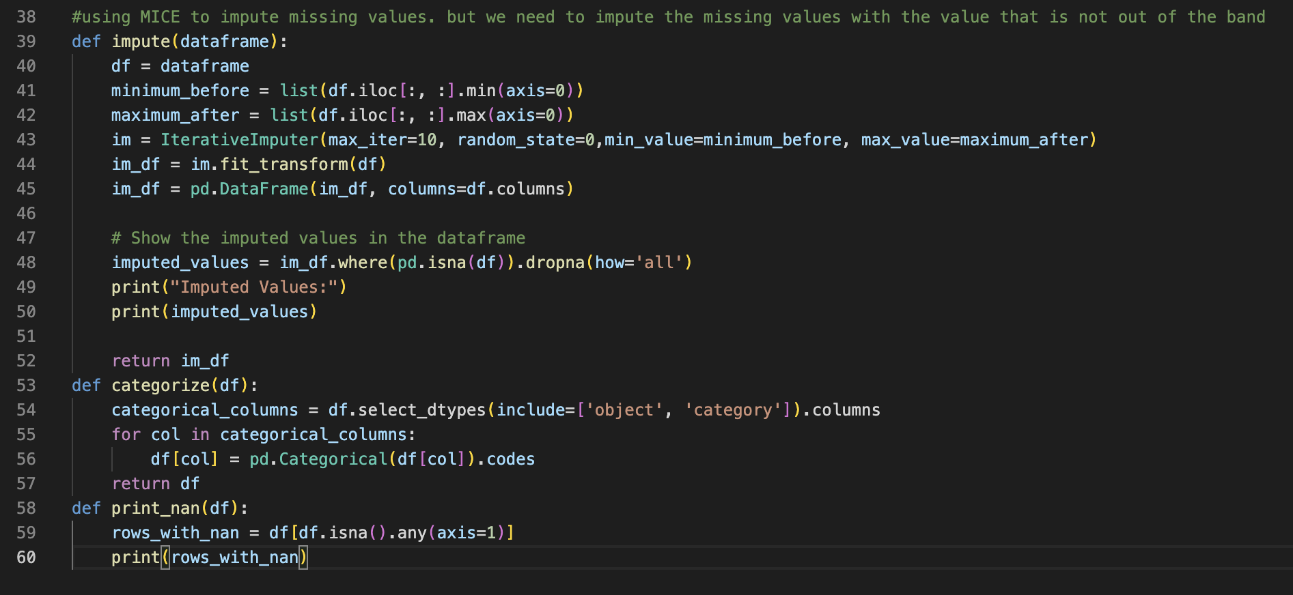
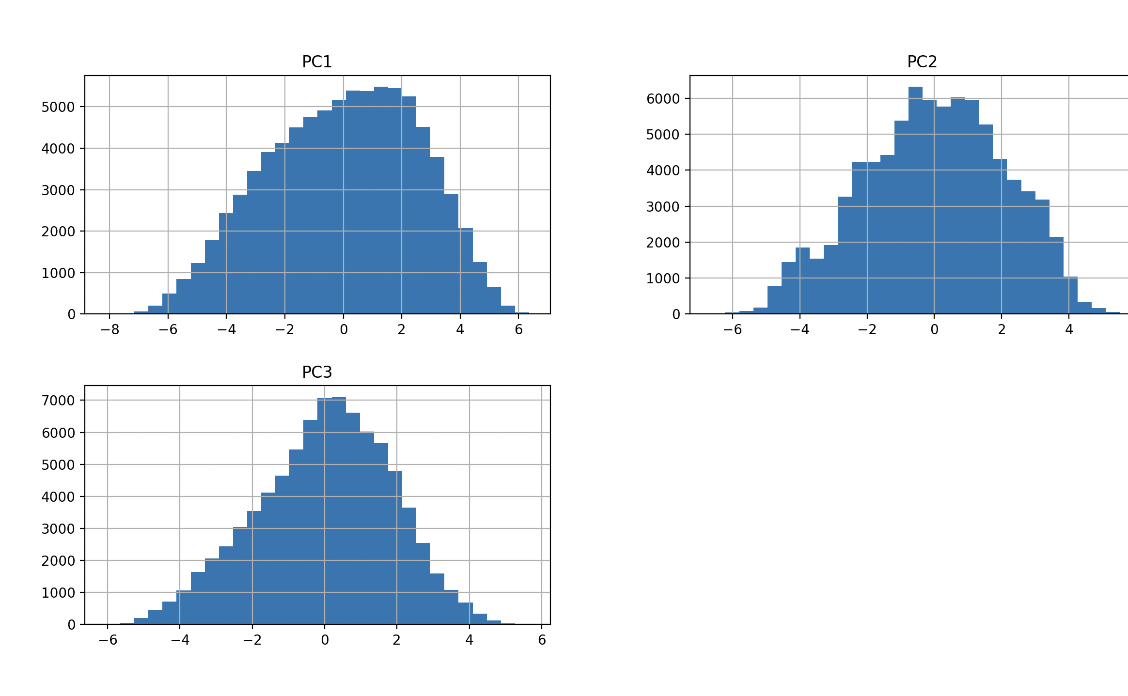
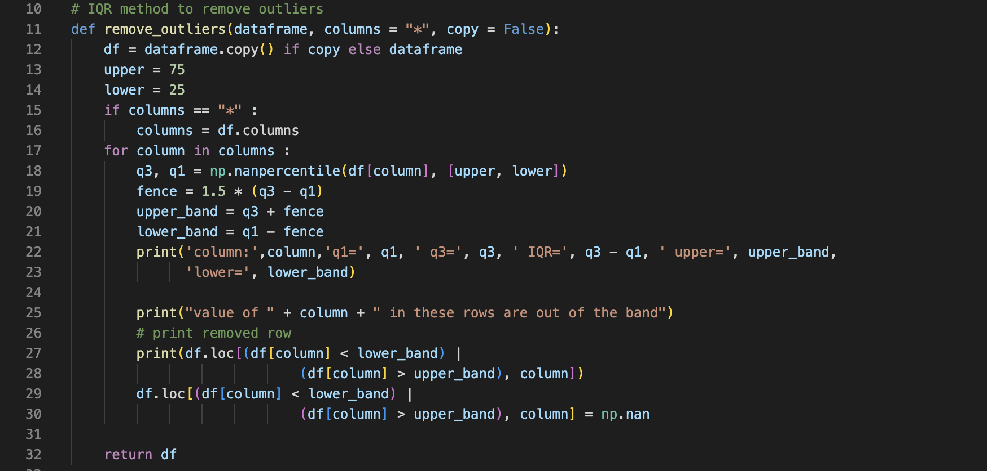
Data Preprocessing
Key Preprocessing Steps
Data Cleaning
Handled categorical variables
Imputed missing values using MICE (Multivariate Imputation by Chained Equations)
Normalized numerical features
Feature Extraction
Applied Principal Component Analysis (PCA)
Reduced feature space to 3 principal components
Preserved most significant variance in the data

Slide 17
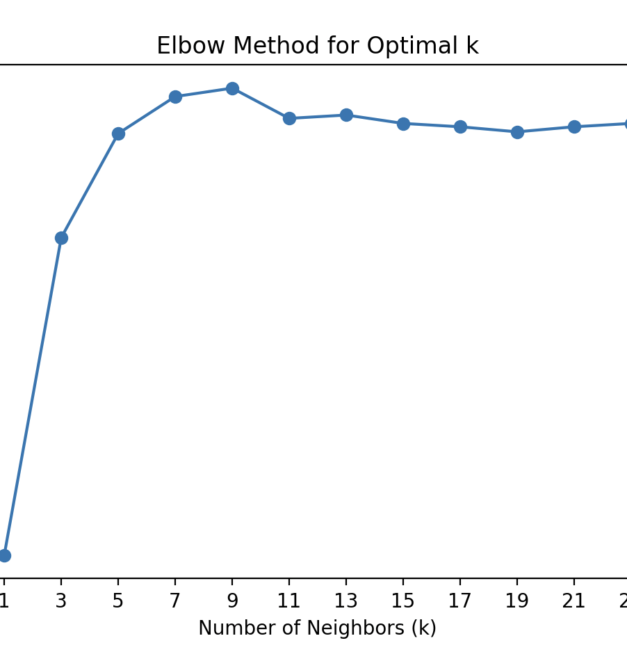
Machine Learning Models
1. Naive Bayes Classifier
Used Gaussian Naive Bayes
Assumptions: Features follow normal distribution
Leveraged probabilistic approach for classification
2. K-Nearest Neighbors (KNN)
Performed hyperparameter tuning
Explored different:
Number of neighbors
Distance metrics
Weighting schemes
3. Neural Network
Multilayer architecture
Hyperparameter optimization:
Number of hidden layers
Neurons per layer
Activation functions
Optimization algorithms

Slide 18
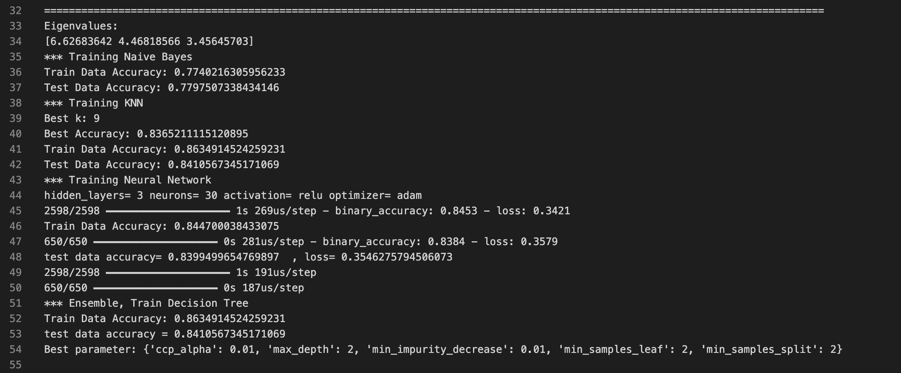
Results and Insights
Model Performance
Each model's performance evaluated on test dataset
Ensemble approach aimed to leverage strengths of multiple models
Detailed accuracy comparisons available
Overall, the results show that the KNN model performed the best, followed by the ensemble decision tree, the neural network, and the Naive Bayes classifier.
Notes:
Naive Bayes Classifier:
The Naive Bayes model achieved a training accuracy of 77.40% and a test accuracy of 77.98% on the airline satisfaction dataset.
This suggests the Naive Bayes model was able to reasonably predict passenger satisfaction, though its performance is not as strong as the other models explored.
The Naive Bayes approach relies on the assumption that features follow a Gaussian distribution, which seems to be a reasonable approximation for this dataset.
K-Nearest Neighbors (KNN):
The KNN model achieved the best performance, with a training accuracy of 86.35% and a test accuracy of 84.11%.
The best value of k (number of neighbors) was found to be 9 through hyperparameter tuning.
KNN is a powerful algorithm that can capture complex decision boundaries, which appears to have been effective for this classification task.
Neural Network:
The neural network model had a training accuracy of 79.14% and a test accuracy of 79.48%.
The network architecture consisted of 1 hidden layer with 5 neurons, using ReLU activation and the Adam optimizer.
While the neural network did not outperform the KNN model, it still provided reasonable predictive performance on the test set.
Neural networks can be sensitive to hyperparameter choices, so further tuning of the architecture and hyperparameters could potentially improve its performance.
Ensemble Decision Tree:
The ensemble approach using a decision tree achieved a test accuracy of 84.11%.
This demonstrates that combining the predictions from the individual models (Naive Bayes, KNN, and Neural Network) can improve the overall performance compared to the standalone models.
The decision tree hyperparameters were tuned, with the best configuration being a maximum depth of 2, minimum impurity decrease of 0.01, minimum samples per leaf of 2, and minimum samples per split of 2.
Overall, the results show that the KNN model performed the best, followed by the ensemble decision tree, the neural network, and the Naive Bayes classifier. The ensemble approach was able to leverage the strengths of the individual models to achieve better predictive performance on the test set.
These findings provide valuable insights into the effectiveness of different machine learning techniques for predicting airline passenger satisfaction. The strong performance of the KNN model suggests that the underlying patterns in the data can be well-captured by a distance-based approach, while the neural network and ensemble models demonstrate the potential benefits of more complex modeling techniques.

Slide 19
Model Comparison Strategy
Ensemble Approach
Collected predictions from individual models
Used Decision Tree as an ensemble classifier
Combined predictions to improve overall accuracy
Performance Metrics
Primary metric: Classification Accuracy
Cross-validation for robust evaluation
Hyper-parameter tuning using GridSearchCV

